Slide 1
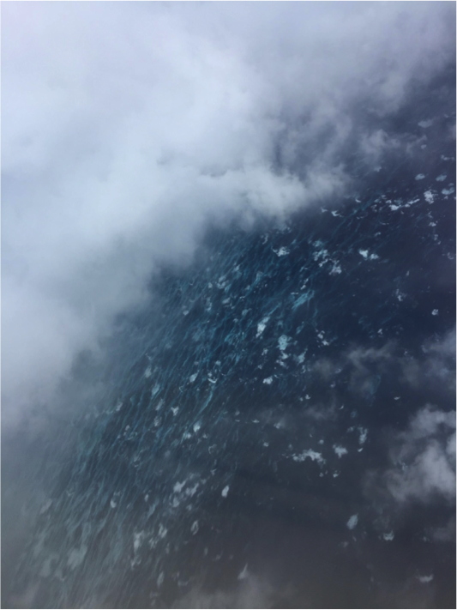
Retrieving/Measuring Extreme Winds Status and Next Steps
IOVWST Virtual Meeting
November 15, 2023
The ocean surface under the eye wall viewed from just inside the eye of Hurricane Matthew

Slide 2
Objectives
To identify and discuss where we think our current understanding of measuring extreme winds is
To identify and discuss the strengths and weaknesses of the various measurement methods (in-situ, satellite and airborne remote sensing)
To discuss research and development areas where the community should focus attention on to address the weaknesses and unknowns.

Slide 3
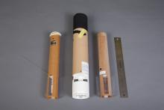
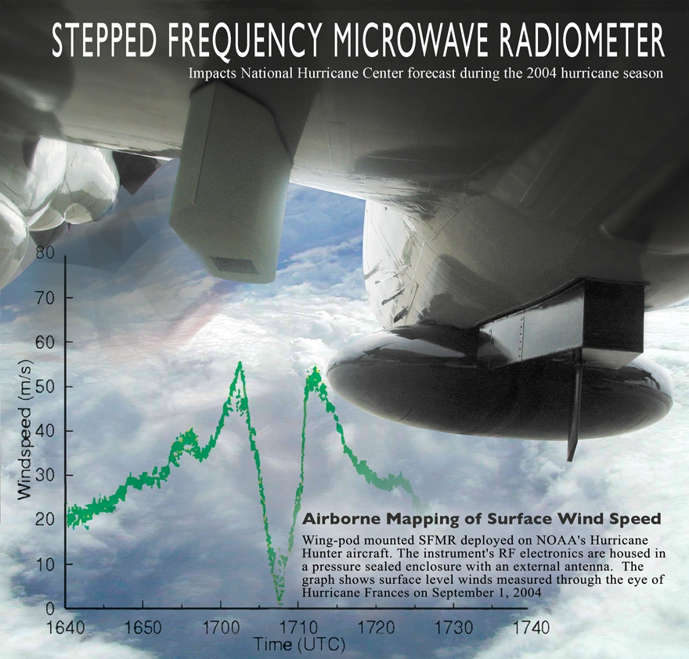
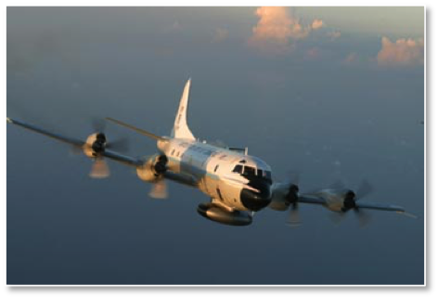
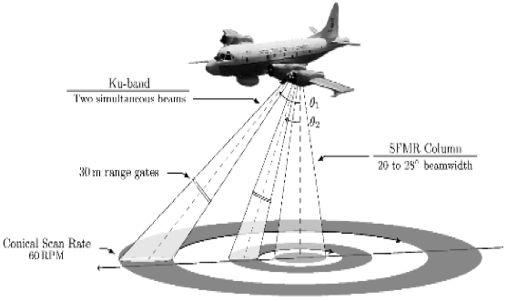
Extreme Winds What do we know and what don’t we know?
What do we have?
Remote sensing
Satellite and aircraft-based sensors
In-situ
Buoys, Dropsondes, Saildrones
Derivative products
Wind radii, peak intensity estimates, RMW

Slide 4
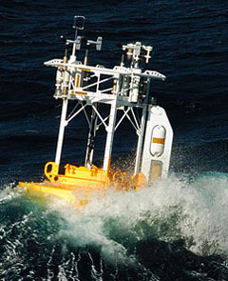
In-Situ – some of the issues
Buoy and dropsondes provide in-situ measurements
Buoys and saildrones get impacted by waves
To what degree? How can we quantify?
High density observations from Saildrone should help understand measurement and geophysical variability
Dropsondes don’t measure the true vertical profile and are also impacted by waves (turbulence at the air-sea interface)
Variability in physical structures in the boundary layer (I.e., fine scale wind structure in the atmosphere) can impact representativeness of what dropsondes/bouys are measuring
Link to seaspray poster

Slide 5
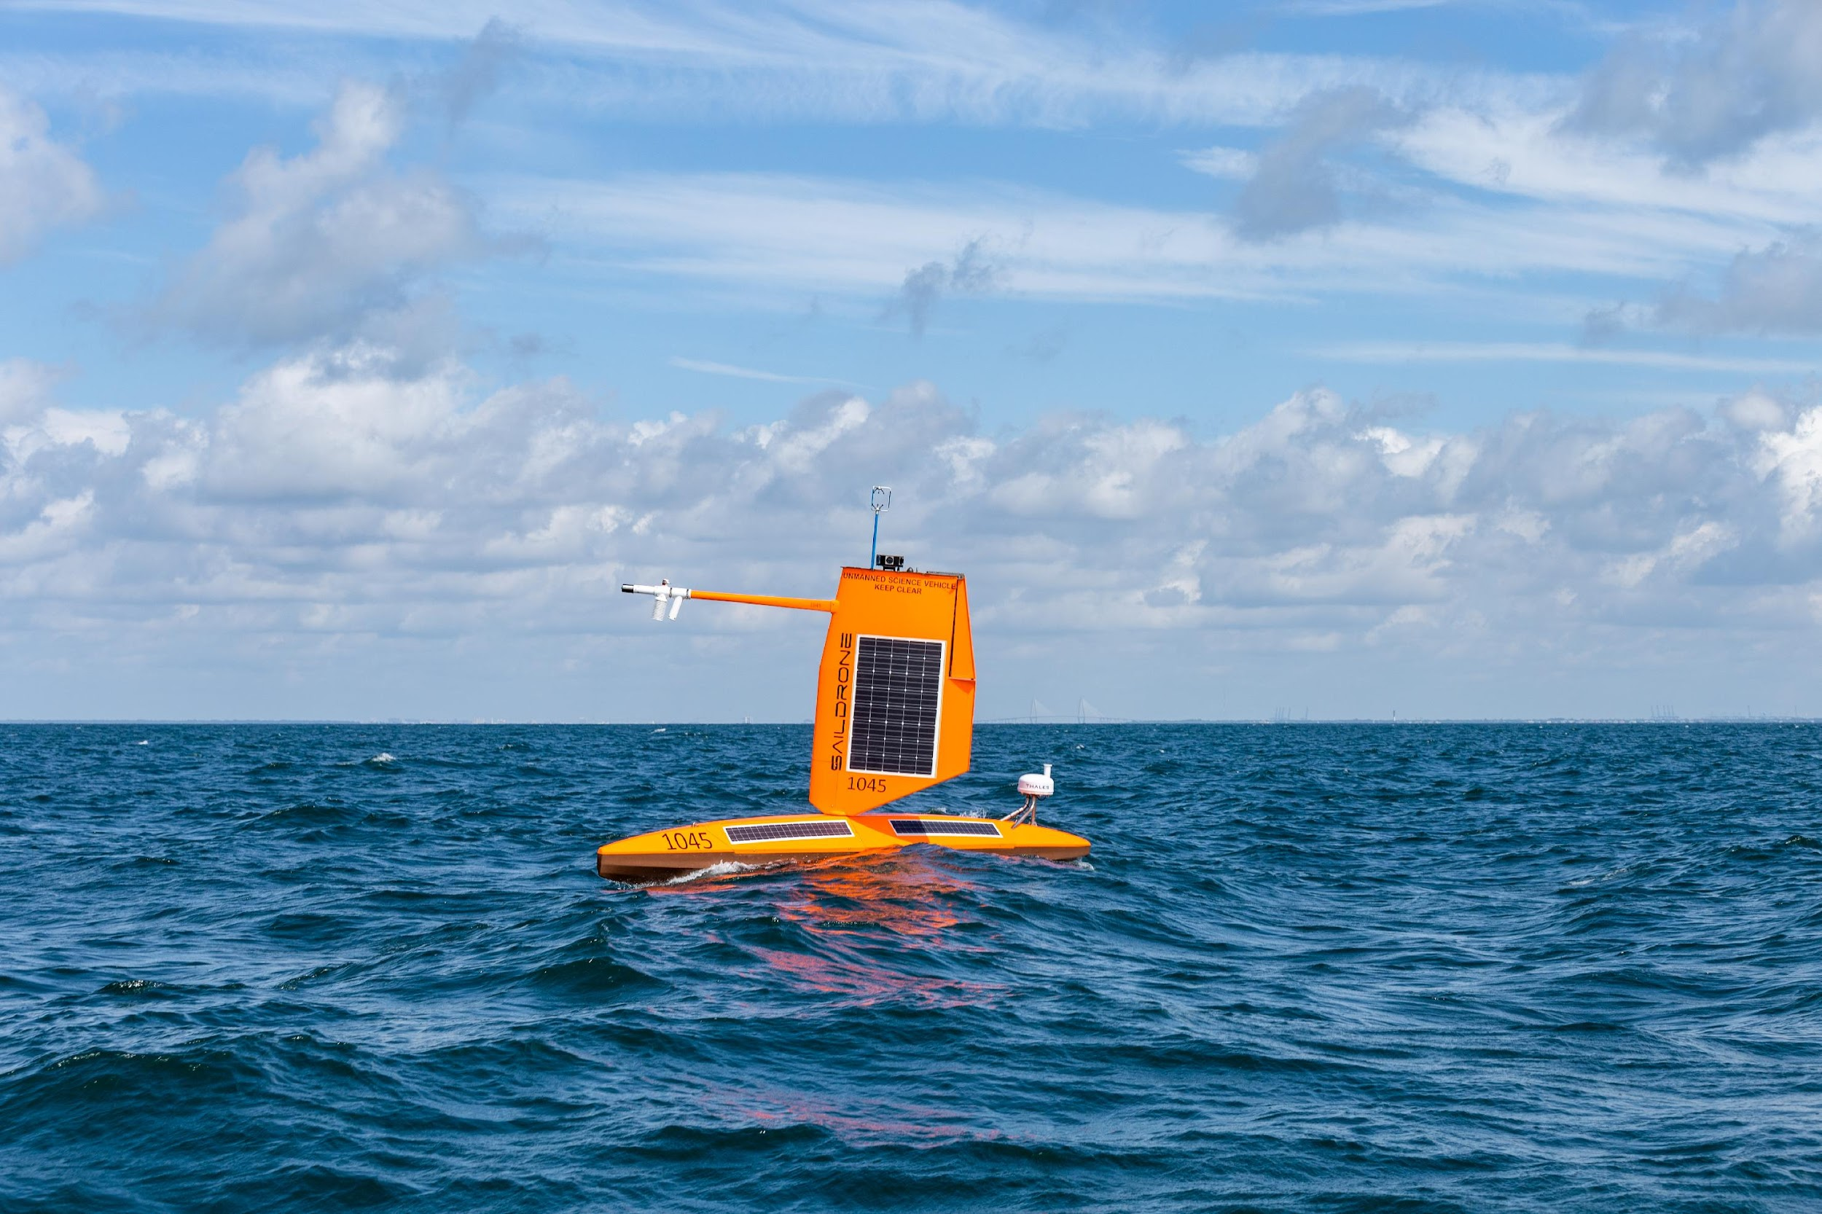
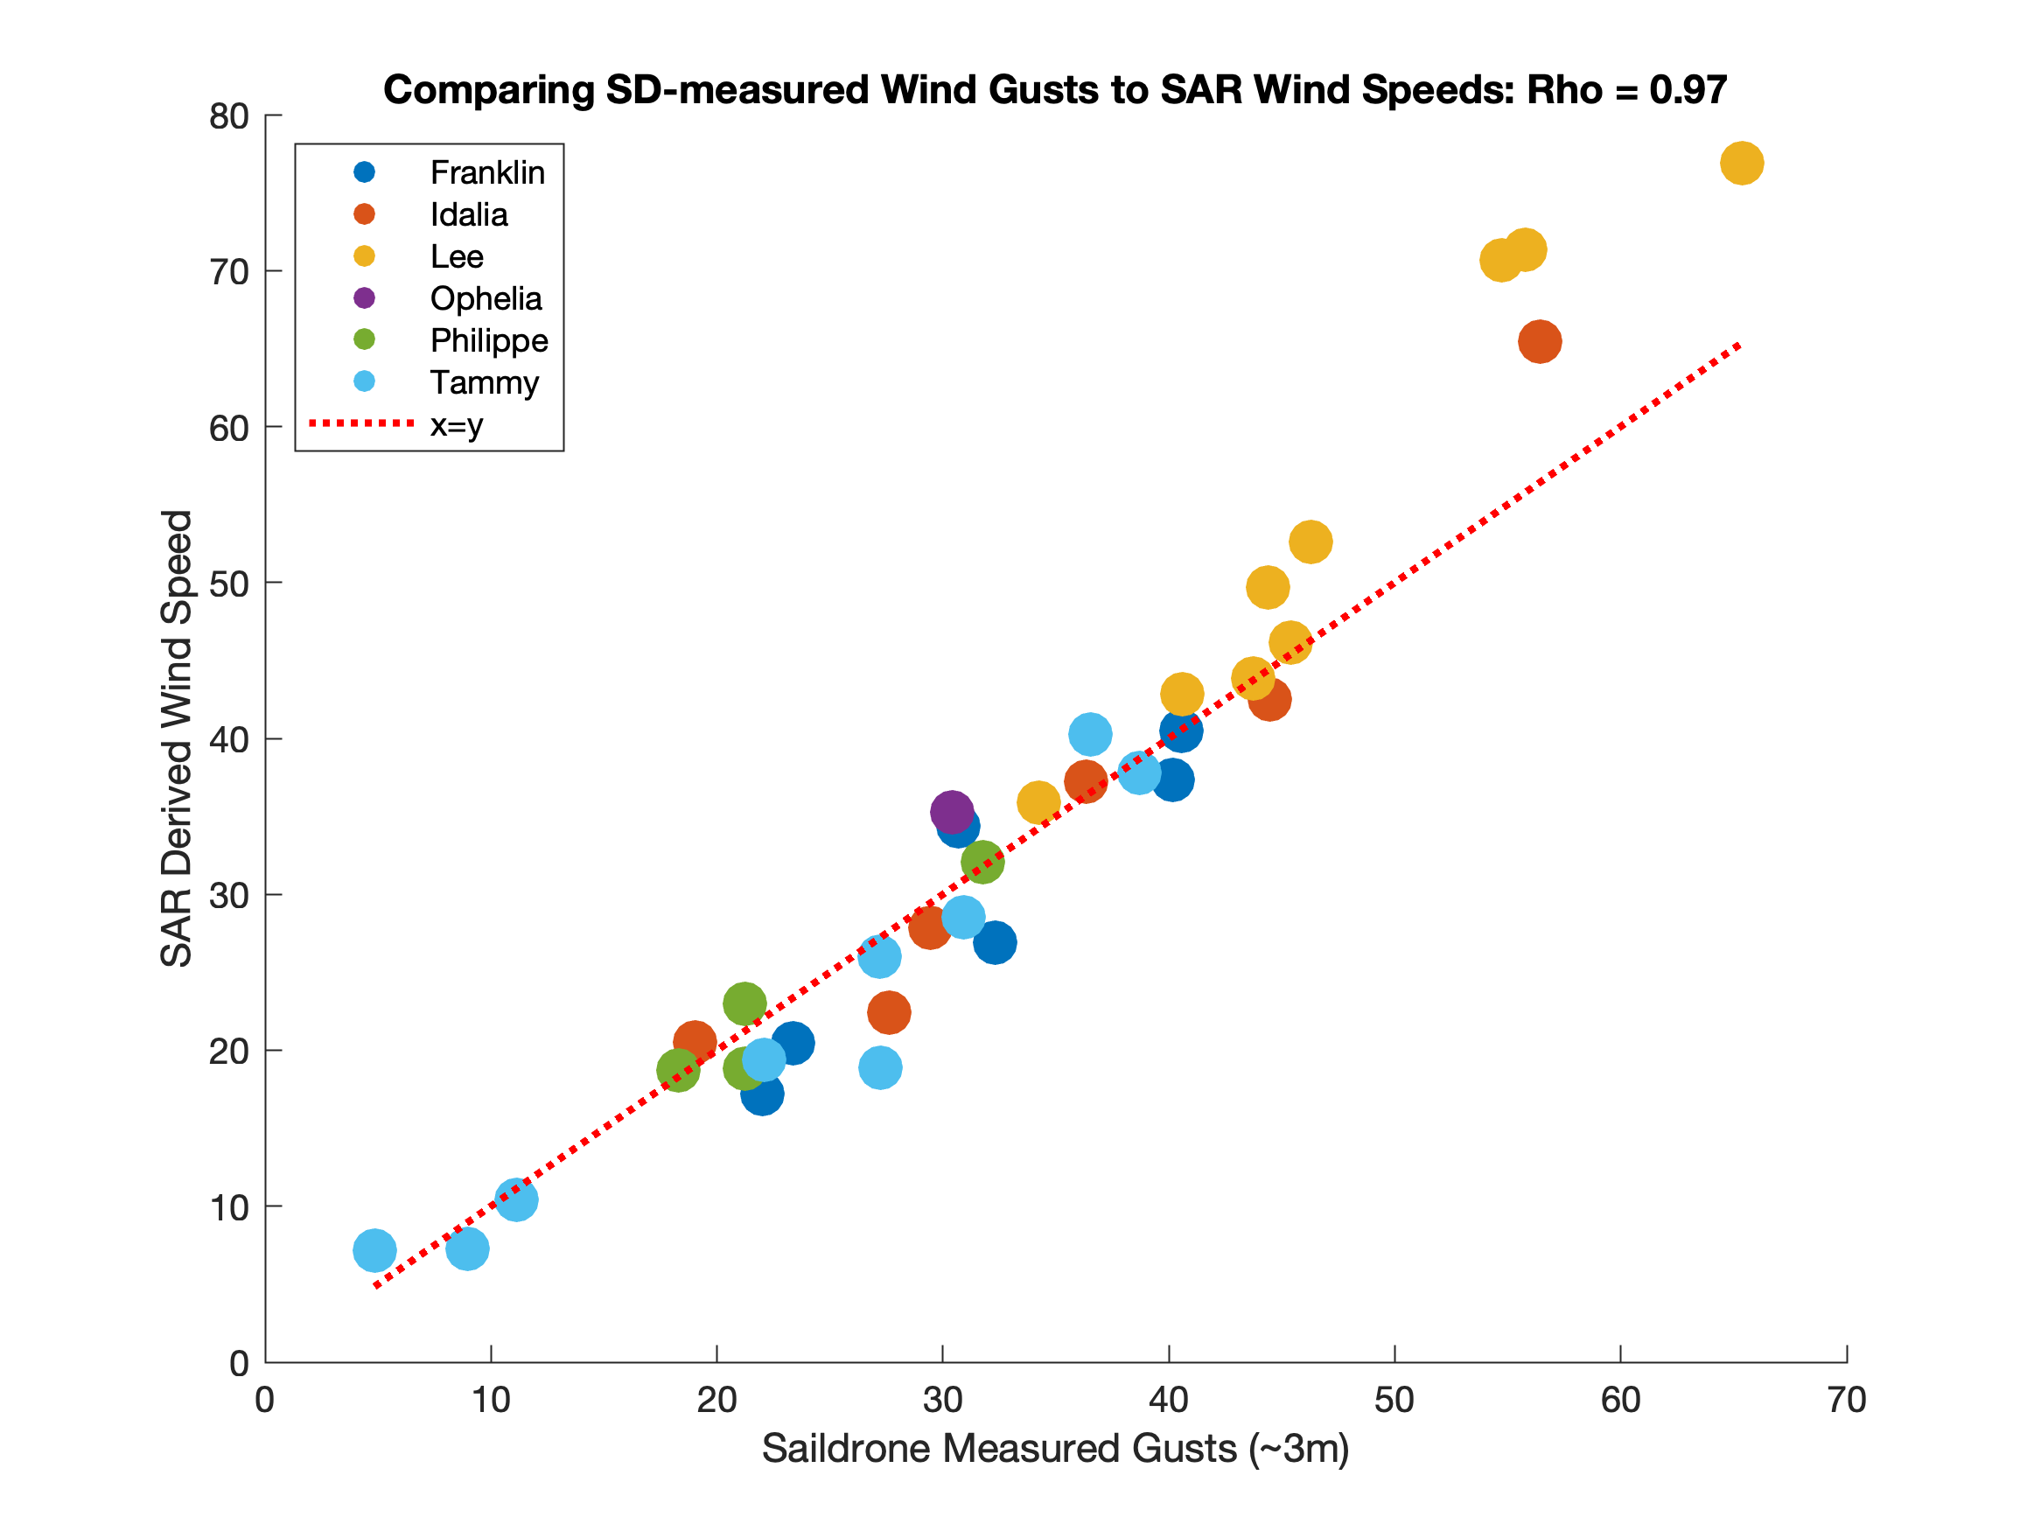
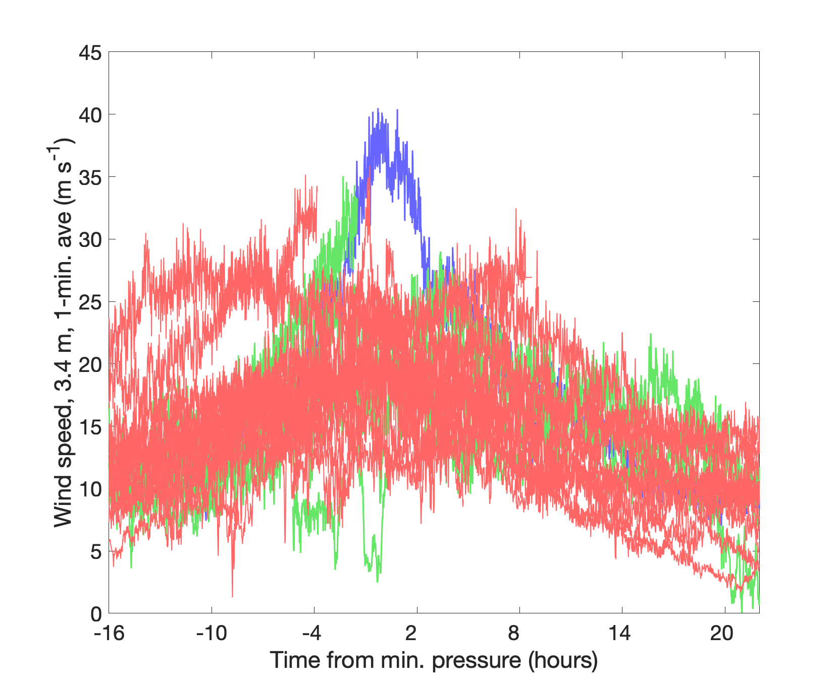
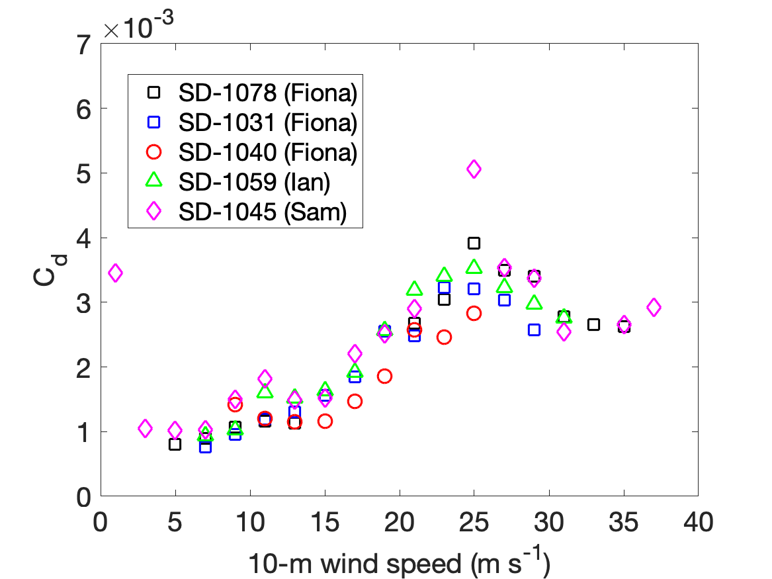
Saildrone wind measurements in hurricanes
Comparison of saildrone and SAR wind speeds
Wind speed from 26 TC intercepts
Franklin
Idalia
Lee
Ophelia
Philippe
Tammy
Sam
2021
2022
2023
Fiona
Idalia
10 20 30
SAR wind speed (m s⁻¹)
Lee
Lee
Drag coefficient from
20-Hz wind measurements
0 10 20 30
Saildrone wind gust (m s⁻¹)

Slide 6
Remote Sensing
What are active and passive microwave remote sensing measurements actually responding to in the extremes?
Does Bragg scattering break down for scatterometry at some point (I think yes)
Does areal foam extent on the surface keep increasing with wind speed
Rain impacts cannot be ignored
Wave conditions impact passive measurements and perhaps active measurements
Spatial resolution is important!
For satellite-based sensors only SAR has the measurement spatial resolution comparable to the areal extent of the highest wind regions in a TC

Slide 7
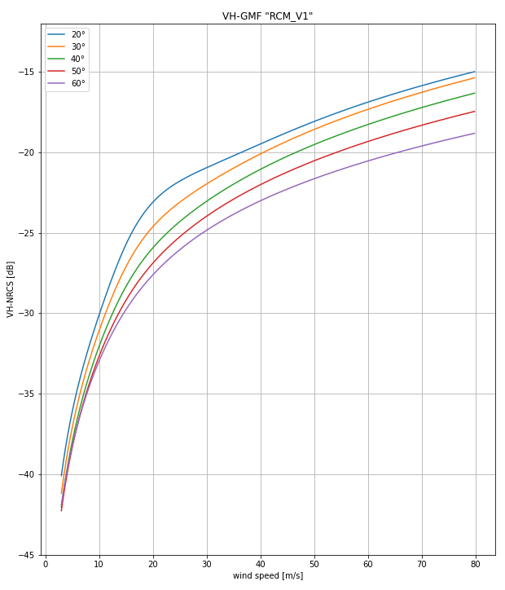
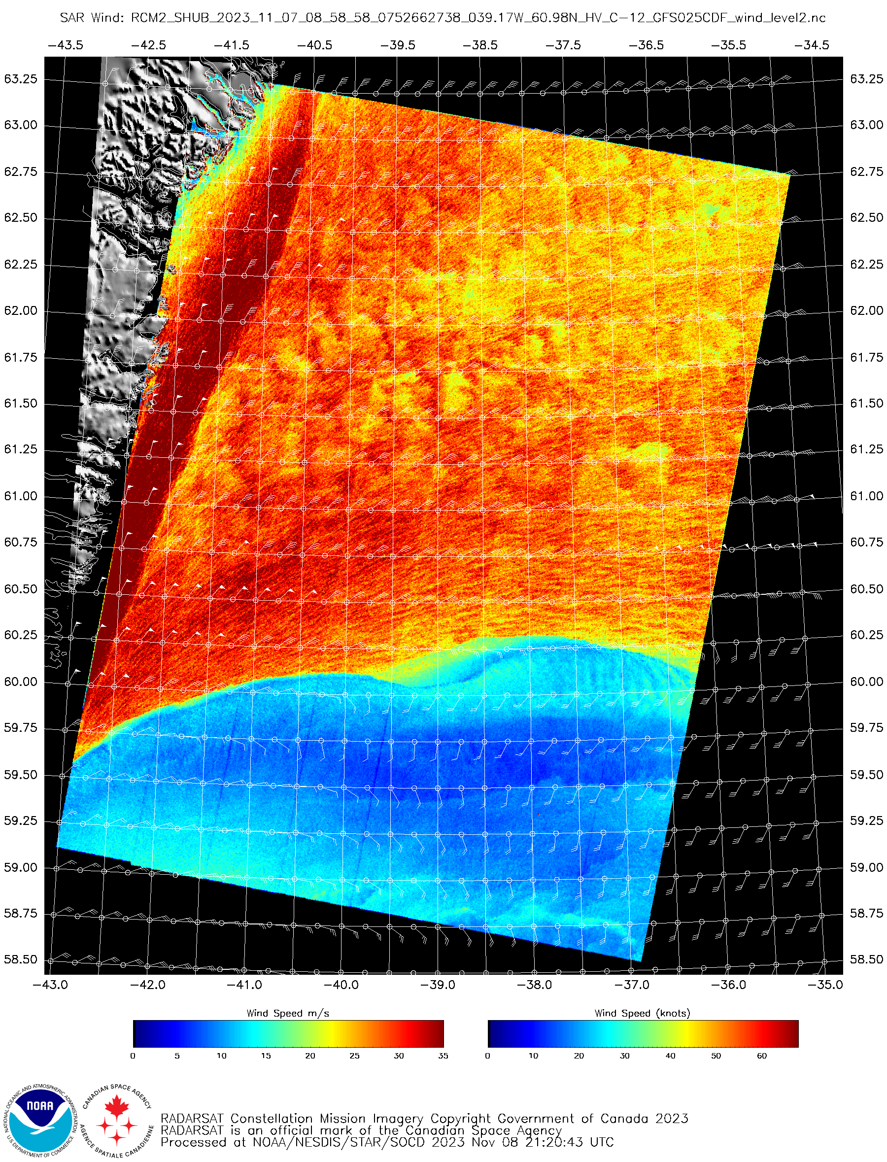
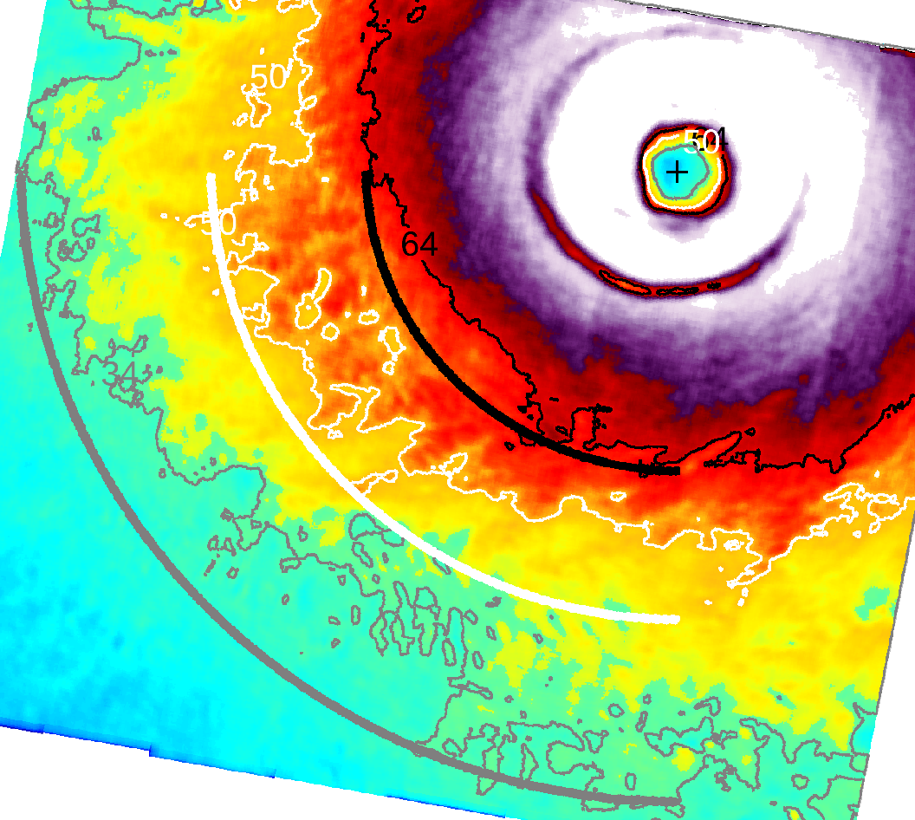
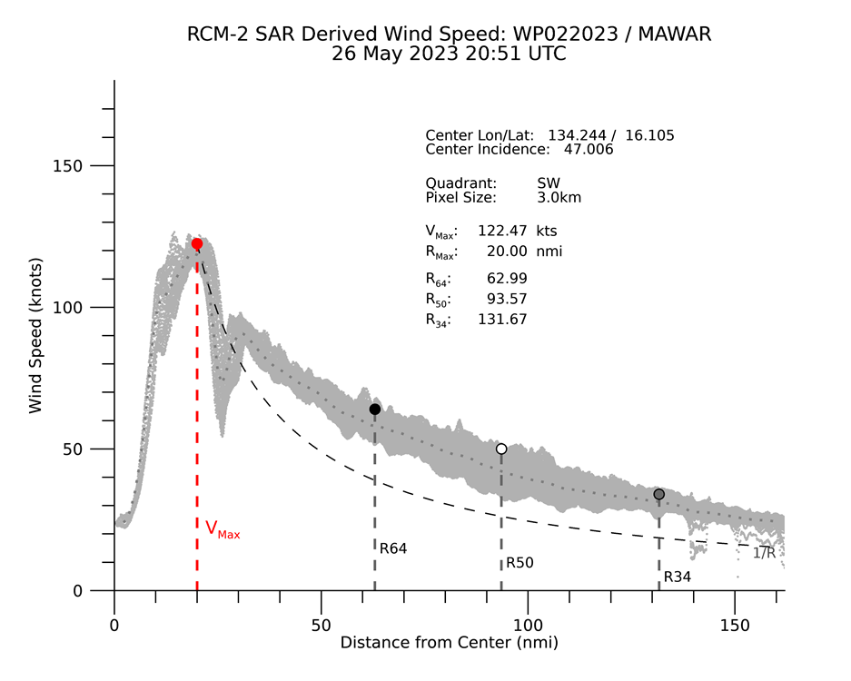
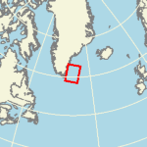
Synthetic Aperture Radar (SAR) for Extreme (> 25 m/s) Winds Determination
The Sentinel-1, Radarsat-2 and Radarsat Constellation Mission (RCM) C-Band SAR systems collect in a cross-polarization (VH or HV) channel that can be used to determine extreme ocean surface wind speeds (up to 80 m/s)
RCM Cross-Pol GMF
RCM-2 HV Winds 07 Nov 2023 08:59UTC
Combined with it’s fine resolution (< 100 m) SAR cross-pol winds provide unprecedented detail into…
tropical cyclones (radial wind profiles, Rmax, VMax, eye location, fixes)
Near shore extreme winds such as gap flows and near shore jets
The cross -pol GMF NRCS is a function of wind speed and incidence angle only
Wind Speed (m/s)
R34
R50
R64
RCM-2 HV Winds
WP022023/Mawar
07 Nov 2023 08:59UTC
Christopher.Jackson@NOAA.gov
~50 KM

Slide 8
Airborne remote sensors
SFMR
Problems in high wind/rain gradient regions (i.e., the eye wall)
Residual calibration errors, wind retrieval process, measurement scheme all impact retrievals
This needs to be characterized
IWRAP
Can measure the actual vertical wind profile in the presence of rain (Doppler) from below the plane to just above the surface and the surface wind via scatterometry
KaIA
SWH at Ka and Ku-band
WSRA
SWH at Ku-band and directional wave spectra

Slide 9
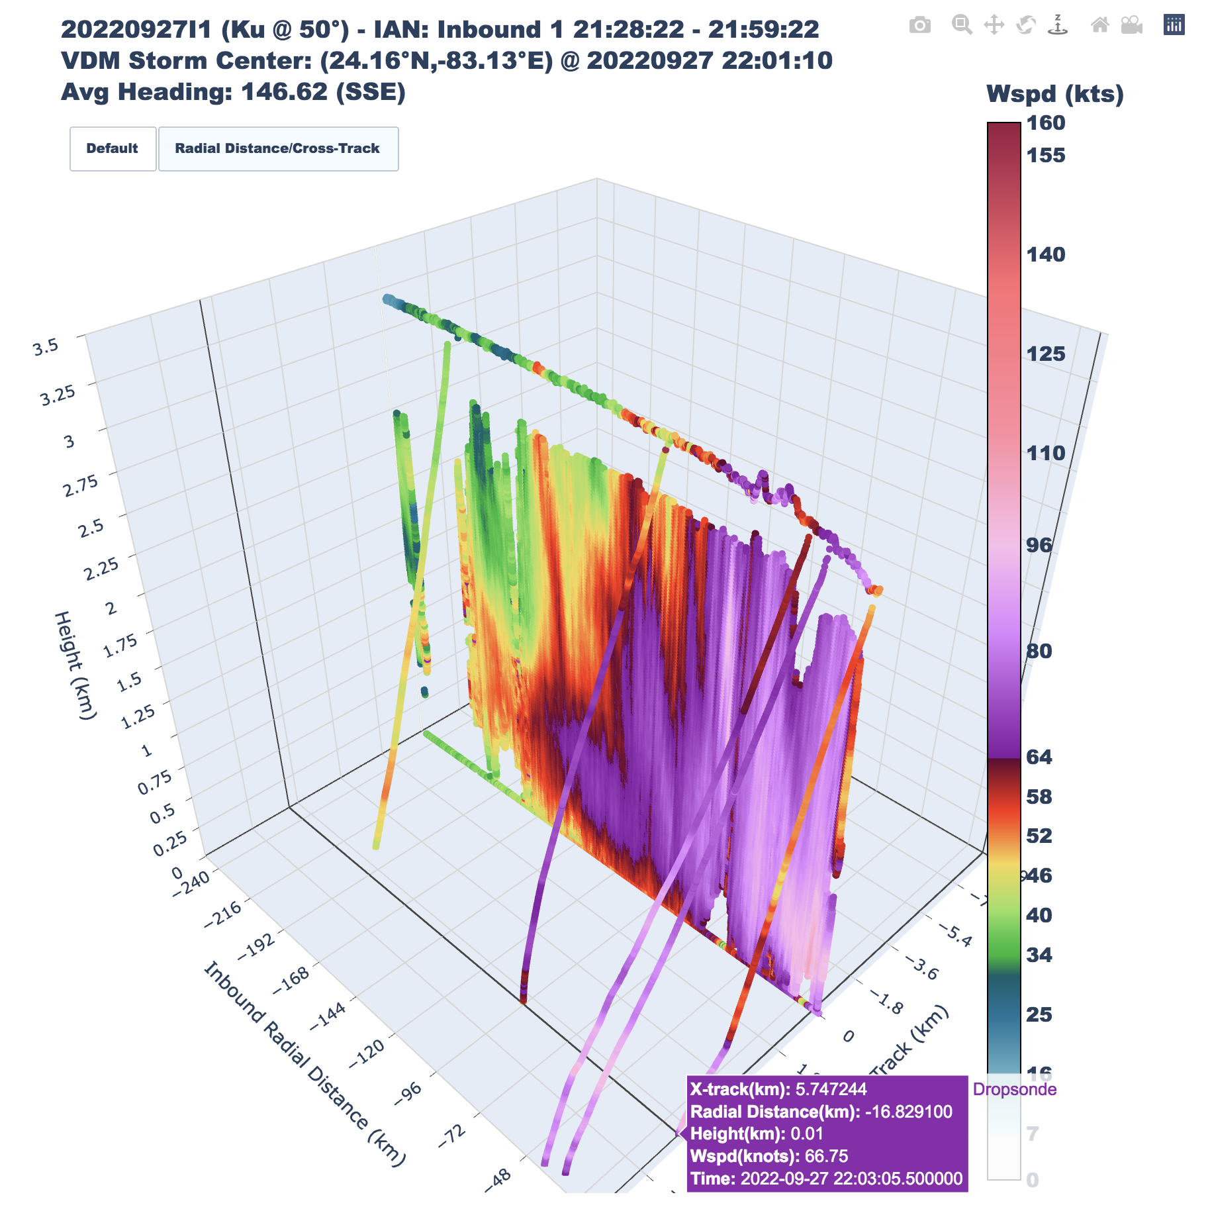
IWRAP Horizontal Winds and Dropsonde Winds

Slide 10
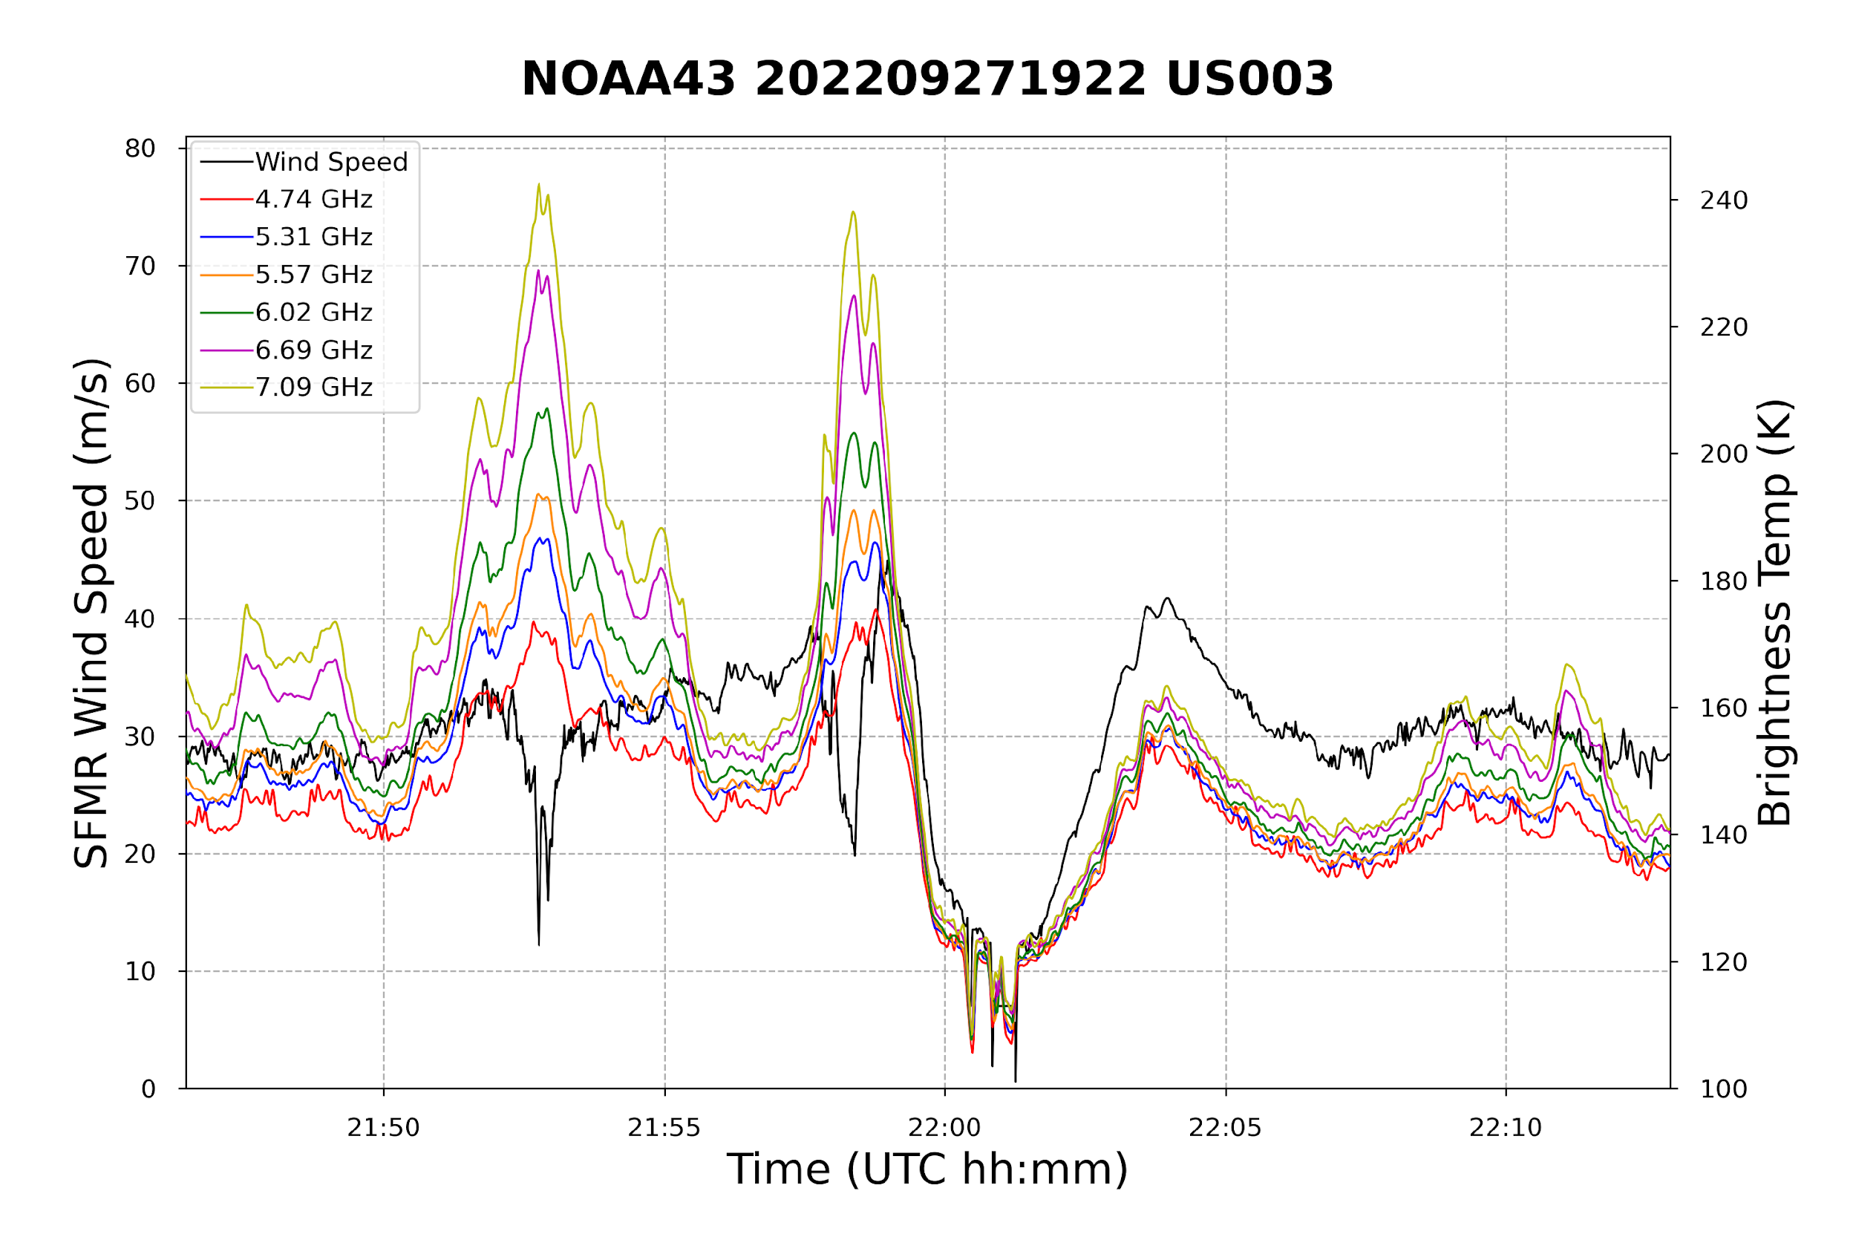
SFMR High Wind/High Rain Errors Heather Holbach – FSU, NGI, NOAA/AOML/HRD
Hurricane Ian 20220827I1
Wind Speed
TB continues increasing when wind speed dips
Rain Rate
Problem with assignment of TB to rain vs wind
Likely a deficiency of the iterative inversion algorithm and sensitivity to first guess
SFMR radiative transfer equations may not be accounting for rain correctly when larger drops are present
Comparisons with TDR, PIP, and IWRAP will be used to investigate and correct algorithm (joint effort with NESDIS team)

Slide 11
Satellite Remote Sensors
Scatterometers
ASCAT B/C
OceanSat-3/EOS-6 (OSCAT-3)
Synthetic aperture radar (SAR)
Passive
SMAP (L-band)
AMSR-2 (multi-frequency 6-89Ghz)

Slide 12
Derivative Products for Operational Weather Users
Extracting more information from existing satellite-based sensors
Particularly important for regions of the world that do not have aircraft TC reconnaissance
Satellite-based sensors also are the only way to systematically measure TCs globally and routinely
All existing satellite data has shortcomings
Satellite estimates in the extremes can still provide valuable information for forecasters
However, critical to provide guidance on use!

Slide 13
JTWC: Wind Product Priorities for Tropical Cyclone Analysis
Tropical cyclone (TC) analysis requires all-weather/all-wind capable sensing:
Wind direction provides critical center positioning
Particularly challenging prior to eye formation
Wind estimates should include the full range of TC intensities, including super typhoon (130+ kts)
Coverage: Storm center to capture maximum associated core wind speeds, extending out 1 to 2 degrees of center to analyze wind radii (34-, 50-, 64-kts)
Revisit: Six-hourly or more frequent (TC warning cycles every six hours)
Satellite winds have significant impact on numerical models that initialize with TC vitals parameters
Heavily influence forecaster analysis of key vitals parameters
TC intensity forecast model (e.g., HAFS, COAMPS-TC) vortex initialization highly dependent on 2D wind structure provided in TC vitals data
Informing the forecaster with accurate wind data directly improves accuracy of operational model forecasts used by U.S. and international forecast agencies!
Approved for Public Release

Slide 14
Space-based Surface Wind Data: Trusted Sources
Active scatterometry is a critical tool for identifying TC circulations since it can provide both wind speed and direction in heavy moisture
Current mean ASCAT TC center revisit time ~28.5 hours ( = a lot > 6 hours ☹ )
Next generation ASCAT capable of overcoming current ~50 knot sensing limitation
Extreme wind speeds derived from Synthetic Aperture Radar (SAR; S1A, RS2, RCM), SMAP, SMOS, and AMSR2 sensors integral to TC intensity and wind radii analysis - all currently provide wind speeds only
SAR particularly useful – resolves small-scale features including TC eye
Wind vectors derived from SAR data a top item on the TC analysis “wish list”
Note: U.S. Indo-Pacific Command and Joint Typhoon Warning Center Tropical Cyclone Conference, mid-April 2024
Annual invitation only gathering of DoD, R&D, academia, and industry partners to synergize TC forecasting, disaster preparedness, and risk communication
POC: Matthew Kucas (matthew.e.kucas.civ@us.navy.mil)
Approved for Public Release

Slide 15
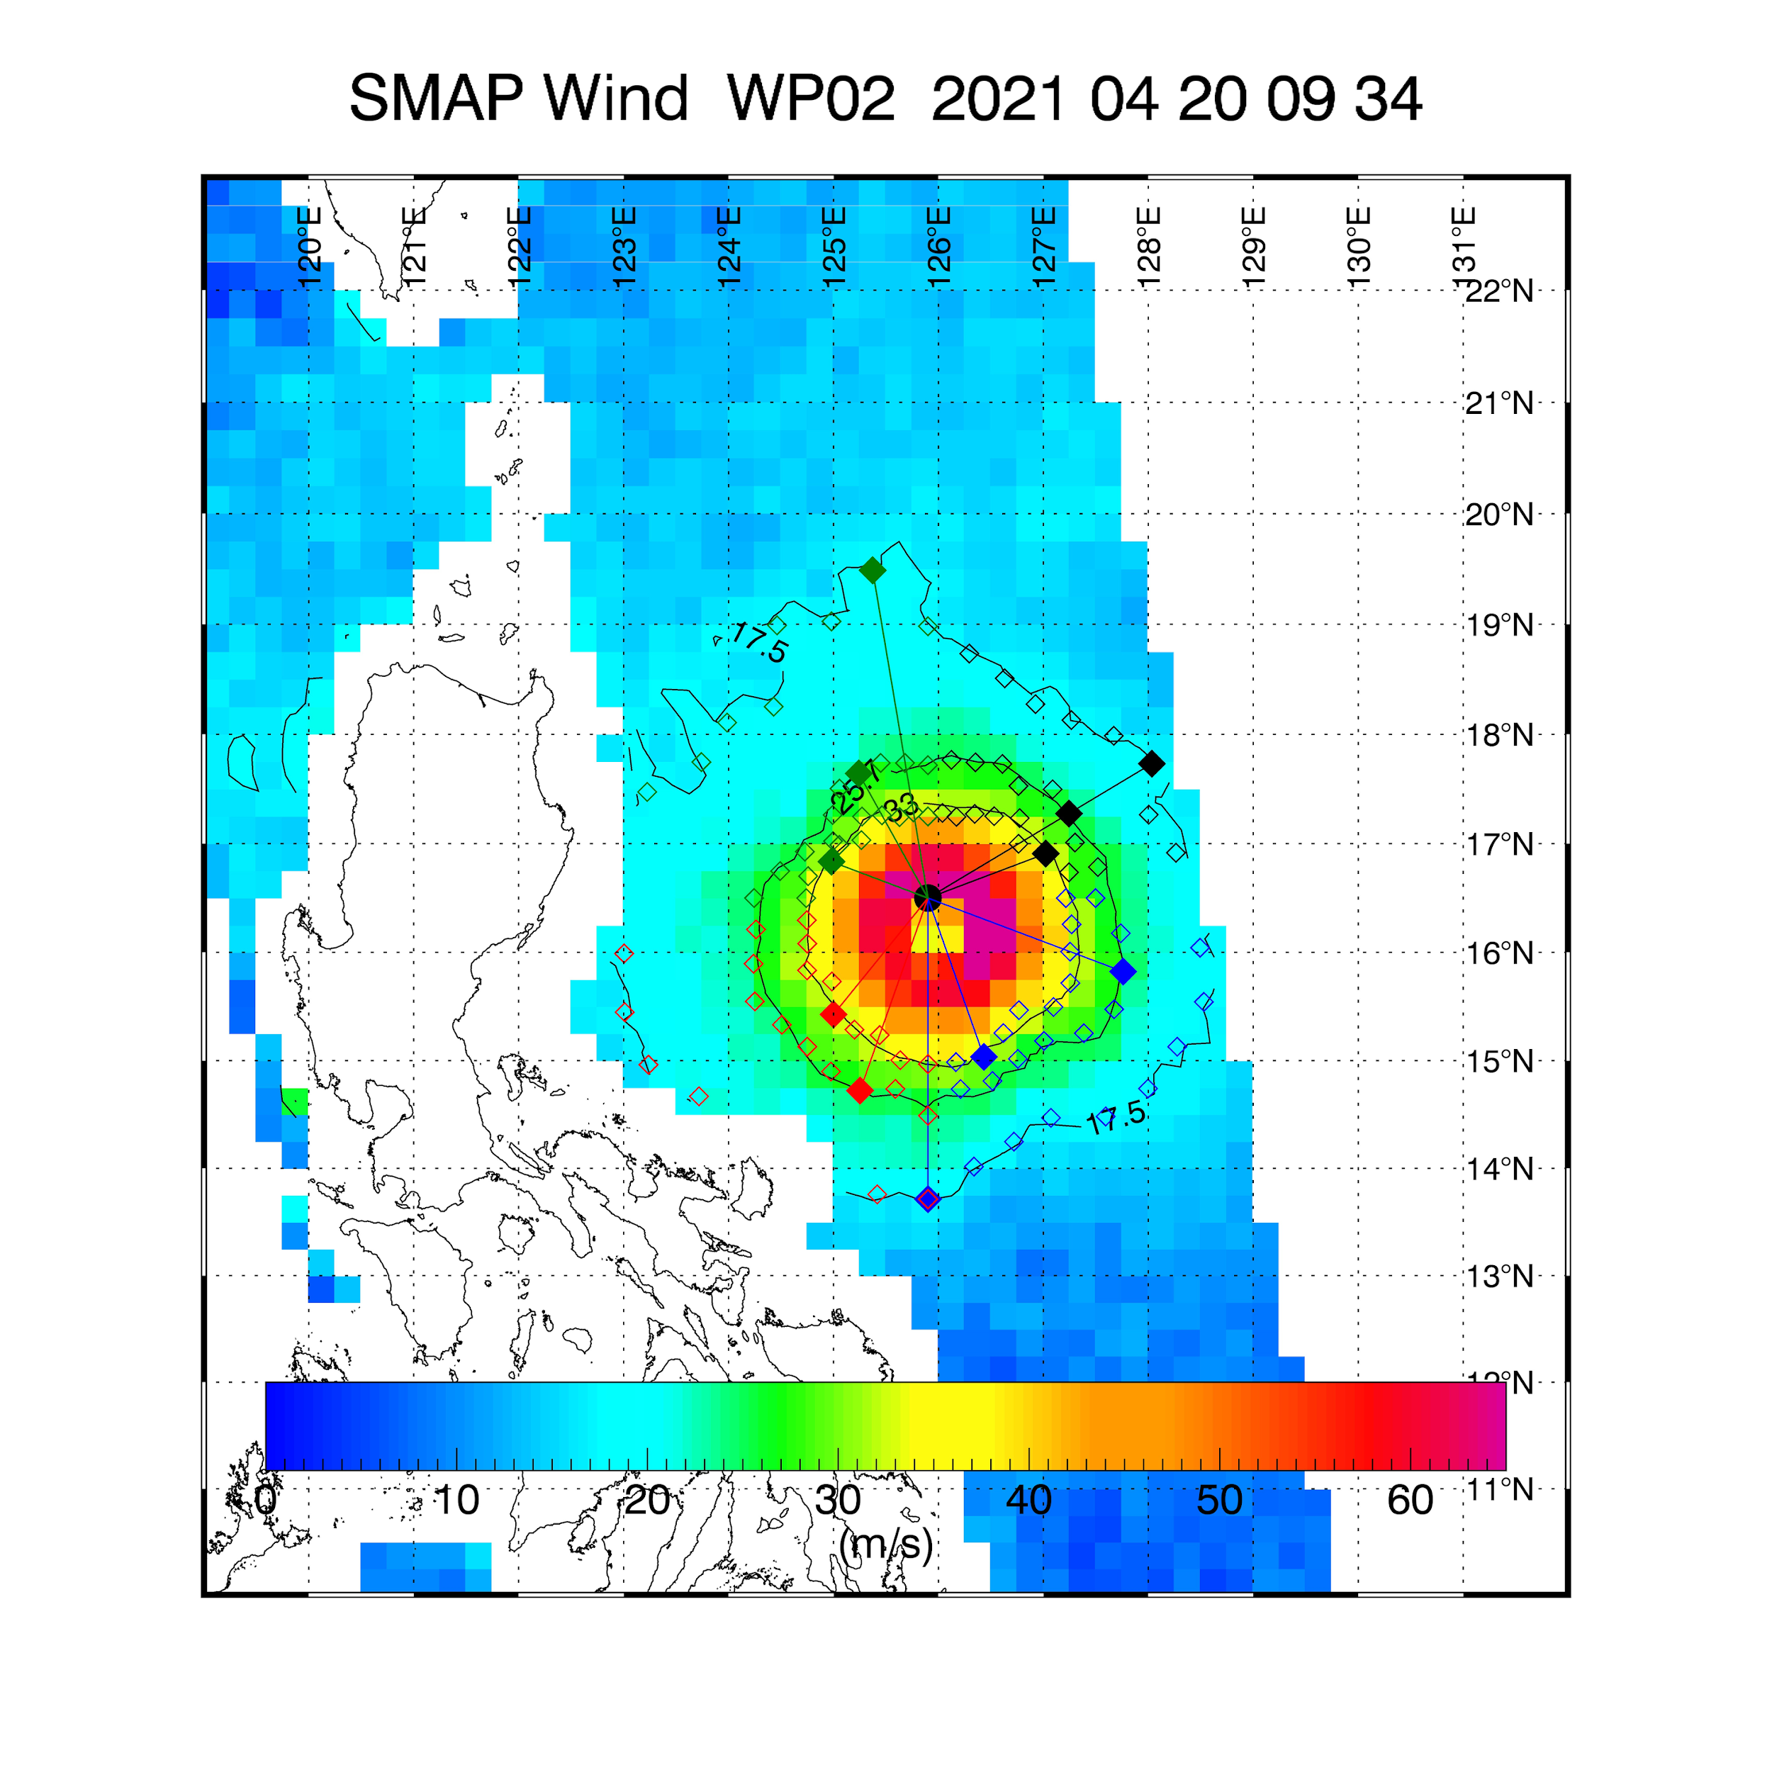
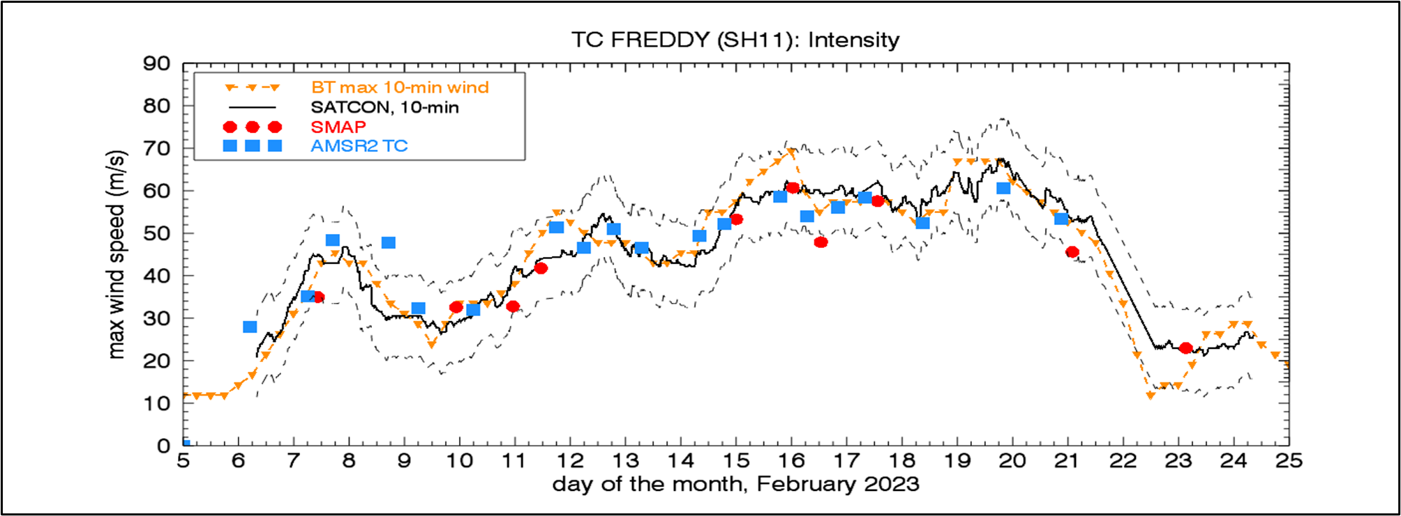
L-BAND RADIOMETERS WINDS: SMAP
Global surface winds, 10-min sustained, 10-70 m/s
L-band very sensitive to high winds but insensitive to rain
At extreme winds, emissivity signal comes mostly from sea foam; linear emissivity at high winds
Footprint: 40 km (over 25 km grid); Uncertainty ~ 10%
Files with TC size and 10-min sustained winds in NRT
Available also as archive (2015-present)
SMAP wind field for SURIGAE (2021), with radii R35, R50, R64 (35/50/64 kt) determined in NRT
C/X BAND: AMSR2 TC-WINDS
TC-specific algorithm trained using SMAP winds
Uses a linear combination of C-X band channels to mitigate rain effect
Provides TC surface wind fields, (10-min sustained winds, 40 km resolution on 25 km grid)
Files with storm size/10-min intensity in NRT
Archive since 2002 (AMSR-E), 2003 (WindSat) and 2012 (AMSR2)
https://www.remss.com/tropical-cyclones/tc-winds/
Consistency AMSR2 TC-WINDS, SMAP Best Track (BT) and SATCON (CIMSS) max winds for TC Freddy (2023). From WMO report, IWTC-10, 2023
Notes:
Ensure images are legible

Slide 16
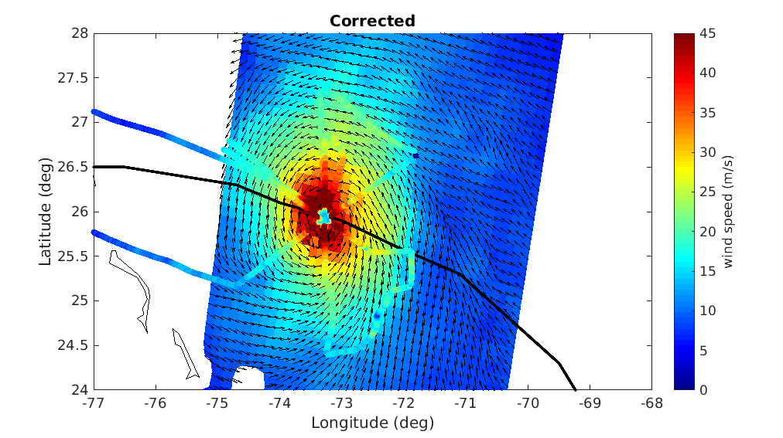
Adjusted ASCAT Winds (KNMI)
Link to poster
ASCAT adjusted wind field over Hurricane Dorian
using SFMR winds as calibration reference

Slide 17
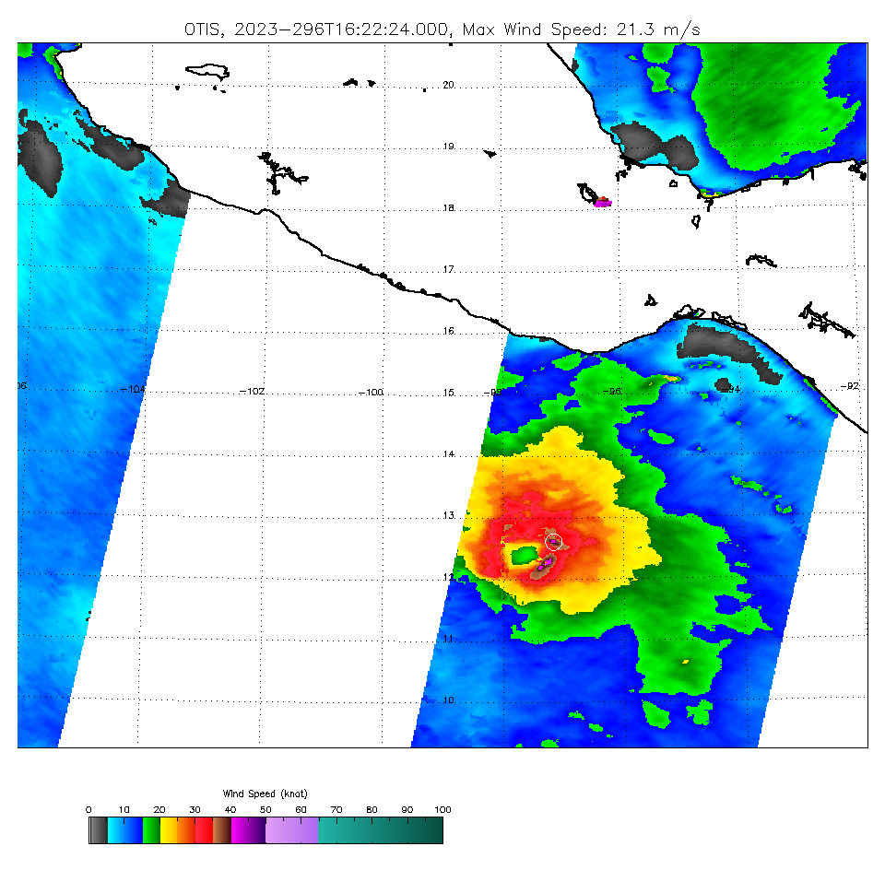
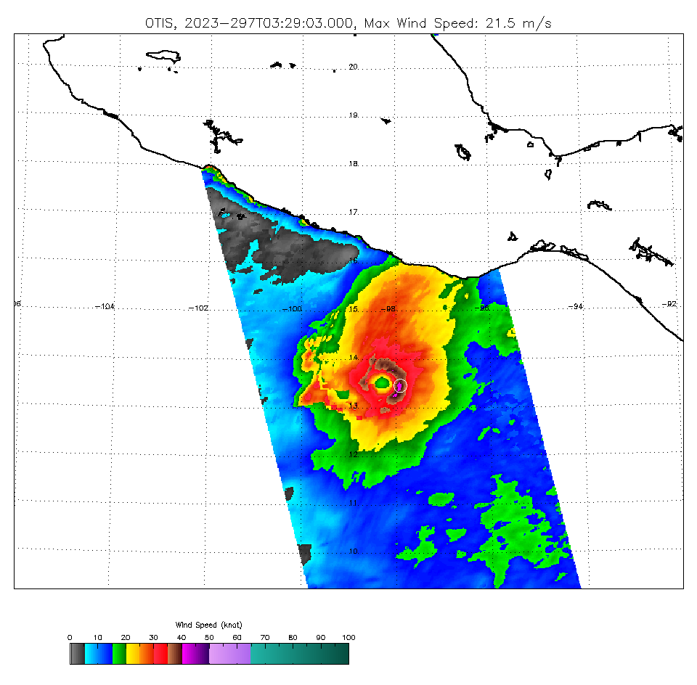
ASCAT UHR (Resolution Enhancement) and TC GMF (NOAA)

Slide 18
Tropical Cyclone Resolution Enhancement for ASCAT Winds
Weicheng Ni, Ad Stoffelen, Kaijun Ren, Jur Vogelgang, Yanlai Zhao, Wuxin Wang
National University of Defense Technology, KNMI
Link to poster
ASCAT Winds
2DVAR SR
A novel method for generating Super-Resolution (SR) winds from low-resolution wind scatterometers is proposed by “learning” the specific TC spatial details from SAR winds at high spatial resolution for different classes of TCs.
The resulting empirical spatial structure functions are used for the assimilation of ASCAT winds and ECMWF forecasts.
(a)
ECMWF Forecasts
SAR Winds
(b)
Poster: Tropical Cyclone Resolution Enhancement for ASCAT Winds
Weicheng Ni, Ad Stoffelen, Kaijun Ren, Jur Vogelzang, Yanlai Zhao and Wuxin Wang

Slide 19
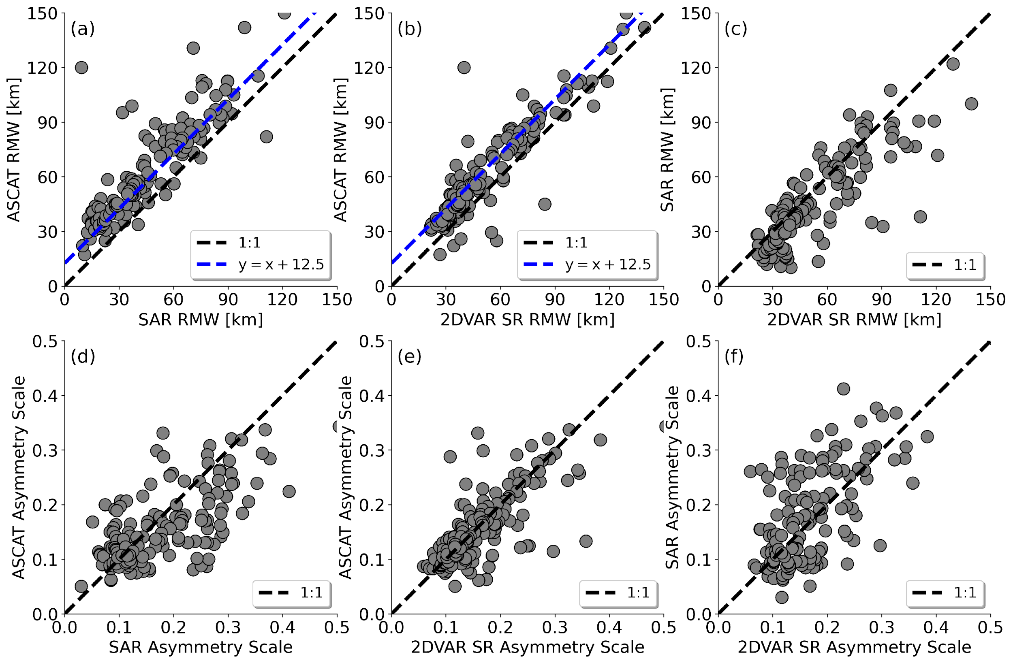
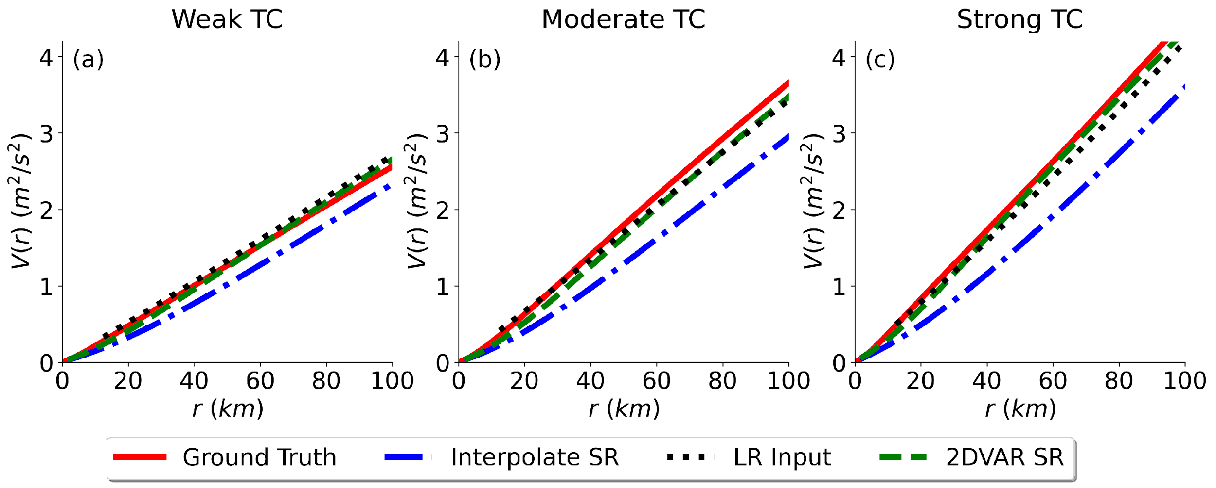
Tropical Cyclone Resolution Enhancement for ASCAT Winds
Link to poster
Morphological Analysis
The proposed SR method is capable of preserving consistency at large scales with original ASCAT winds while compensating for the ASCAT footprint blurring effect of the small-scale information and enhancing TC vortex structures in a physically meaningful manner, regardless of TC strength category.
The obtained SR products possess the correct small-scale properties of TC inner-core structures, such as Radius of Maximum Wind, TC asymmetry and wind variability.
Quality Evaluation by Triple Collocation Analysis
TC Category | SR Method | SAR (m/s) | ASCAT (m/s) | ECMWF (m/s) | (m²/s²) | Number of Points
Weak | 2DVAR SR | 1.51 | 0.57 | 1.51 | 0.31 | 5,034,681
 | Interpolate SR | 1.53 | 0.82 | 1.53 | 0.06
Moderate | 2DVAR SR | 1.42 | 0.60 | 1.43 | 0.35 | 2,891,969
 | Interpolate SR | 1.43 | 0.95 | 1.43 | 0.12
Strong | 2DVAR SR | 1.31 | 0.52 | 1.31 | 0.43 | 1,418,252
 | Interpolate SR | 1.31 | 0.77 | 1.30 | 0.24
Spatial Variance Estimates

Slide 20
Derivative Products
A GMF can be developed to use coarse spatial resolution measurements to infer peak winds in TCs (by adjusting the slope of the GMF).
These products do provide value for TC forecasters
However these products do not resolve the actual wind speeds which are still important to measure (climate monitoring, advancing knowledge of the air-sea interaction process, wind coupling into other parameters, TC forecasting/warning, etc.)
If the spatial resolution of the observing system is larger than the areal extent of the wind speeds being retrieved then the product is indirectly inferring the wind intensity
Next 3 slides illustrate differences one can get using different GMFs for the same measurements.

Slide 21
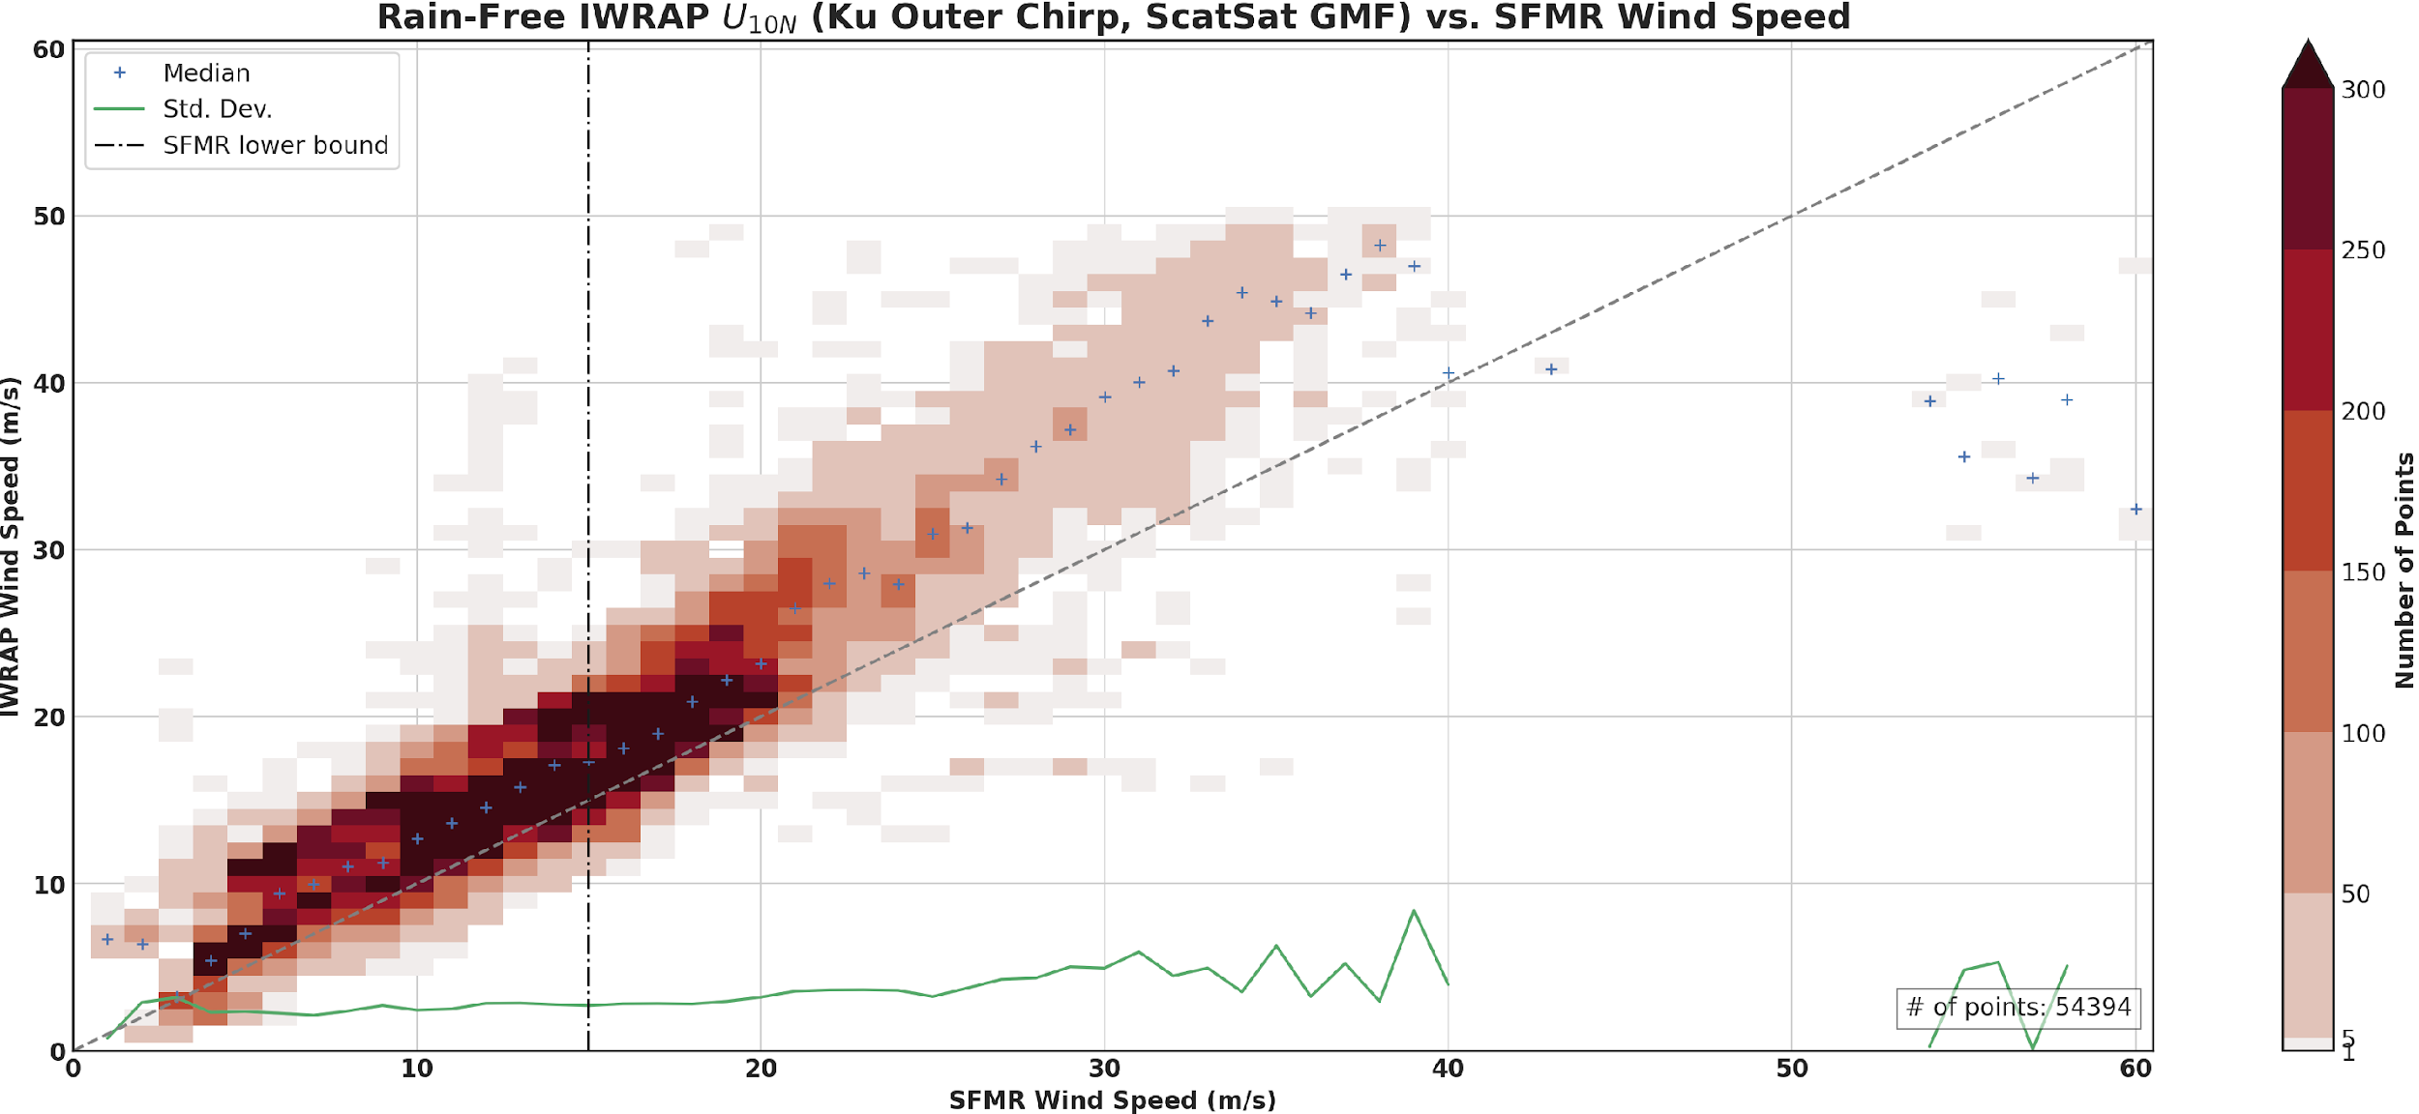
ScatSat GMF Operational SFMR

Slide 22
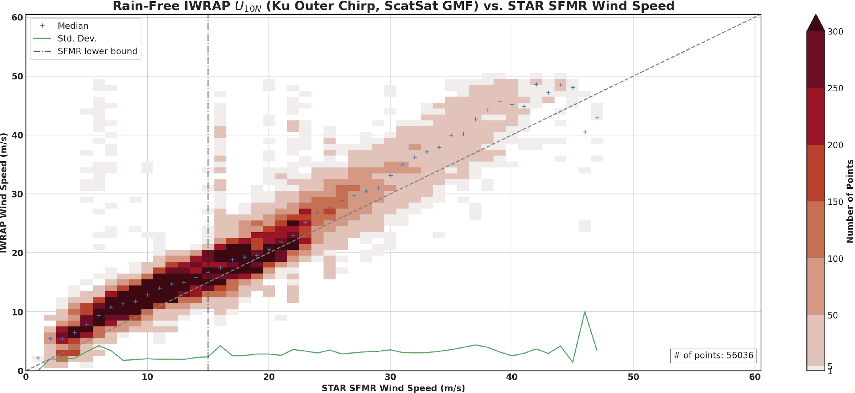
ScatSat GMF STAR SFMR

Slide 23
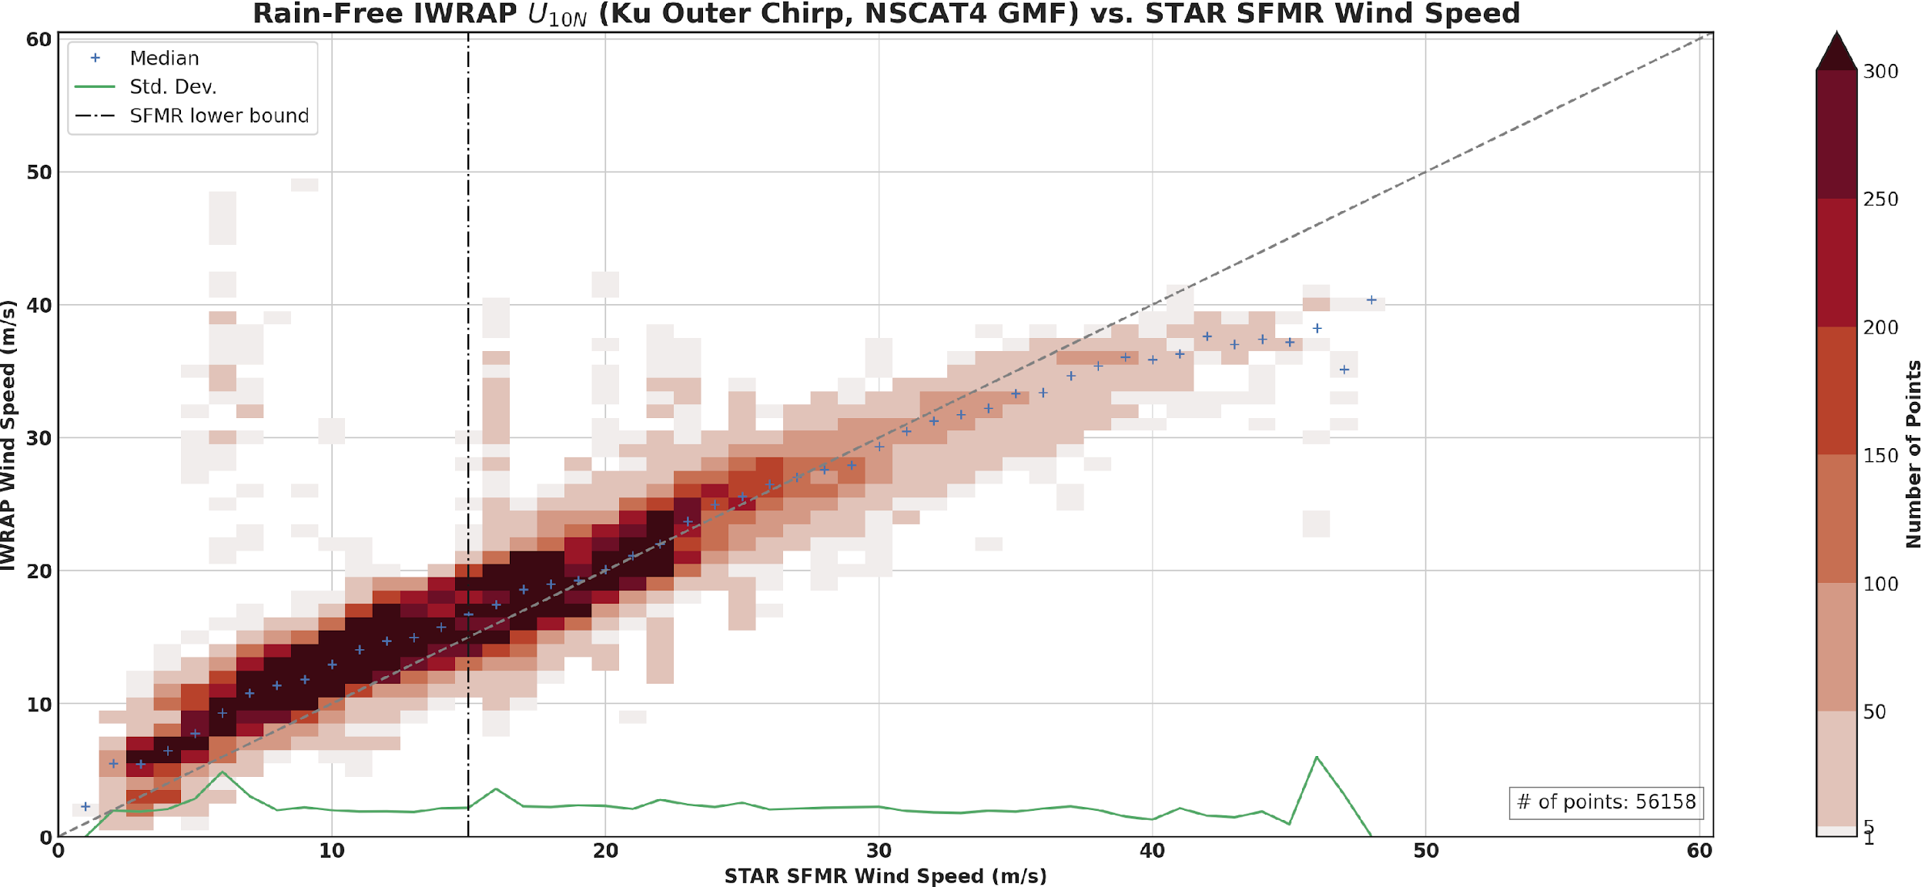
NSCAT4 GMF STAR SFMR

Slide 24
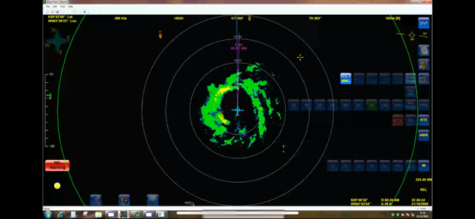
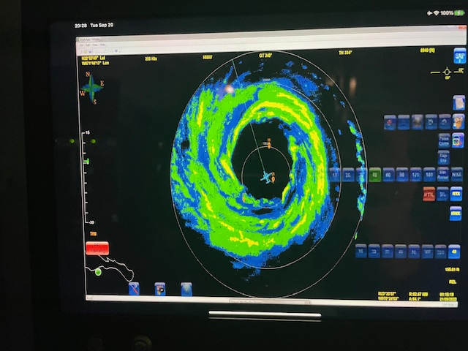
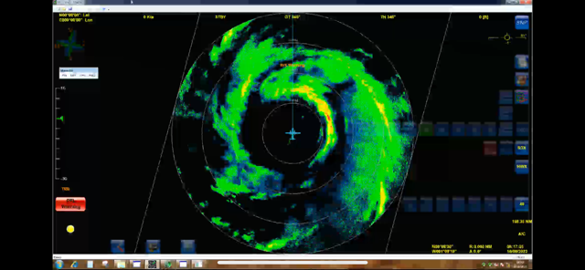
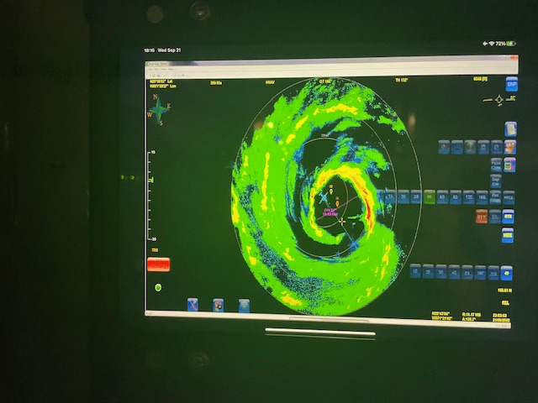
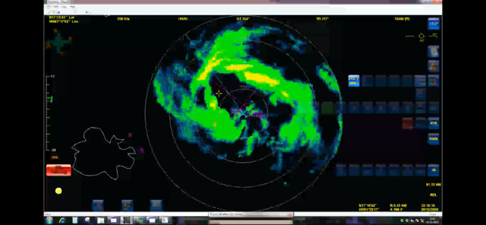
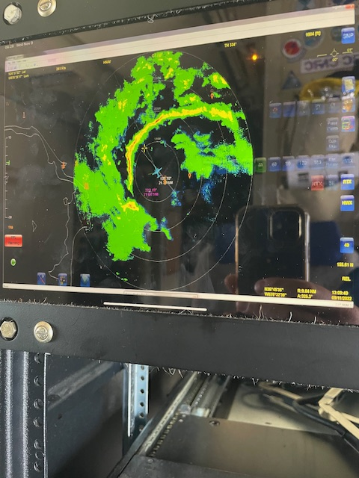
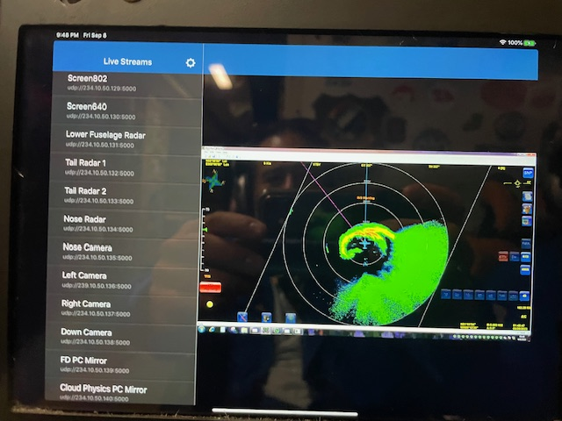
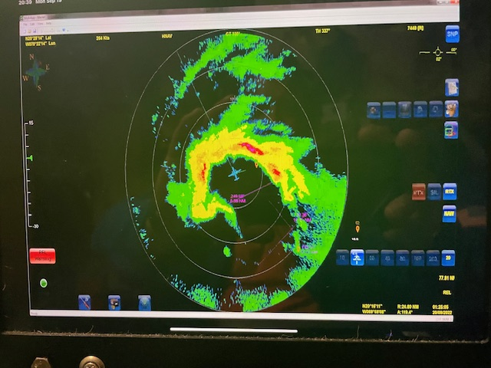
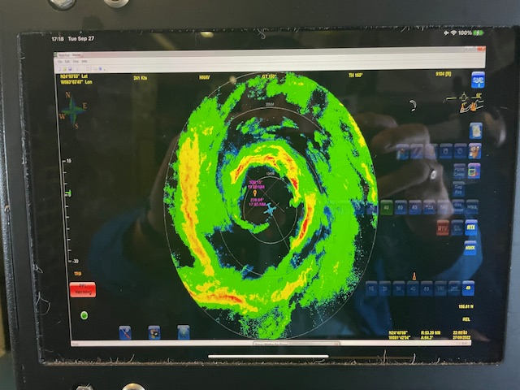
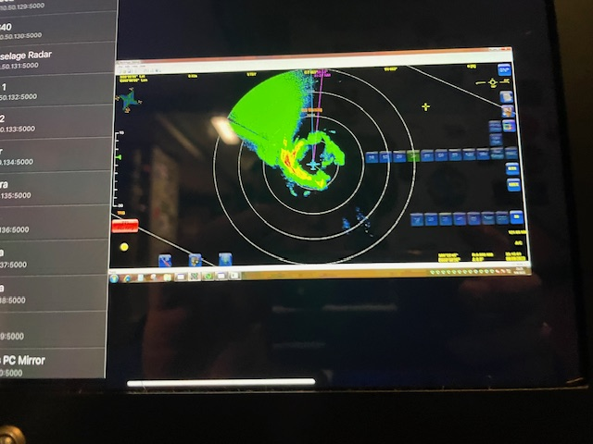
TC eyes vary in shape and size which can’t be resolved properly with coarse measurements

Slide 25
How do we reconcile/What are the next steps?
We need to fully understand and characterize in-situ and airborne remote sensing measurements in the extremes, which will help understand what capabilities are needed for satellite-based sensors
Does enough data already exist?
We can continue leveraging hurricane flights but should we also consider a dedicated field experiment?
3 possible avenues of attack
Characterization of in-situ measurements
Characterization of what remote sensors are actually responding to in the extremes
Continue development and refinement of derivative approaches/product to more fully exploit existing remote sensing measurements

Slide 26
How do we reconcile/What are the next steps?
What should the high wind speed calibration reference be?
SFMR? It does have issues that need to be fully characterized and resolved
Dropsondes?
Perhaps a combination of airborne remote sensing instruments to measure a variety of parameters in the TC environment
What is really happening on the ocean surface in the extremes?
Does the sea spray layer need to be accounted for?
Bragg scattering enhancement (scatterometers) appears to break down at some point
Should the microwave brightness temperature also level off?...there would seem to have to be some maximum foam coverage from wave breaking at some point? Or does the spray layer keep increasing the Tb?

Slide 27
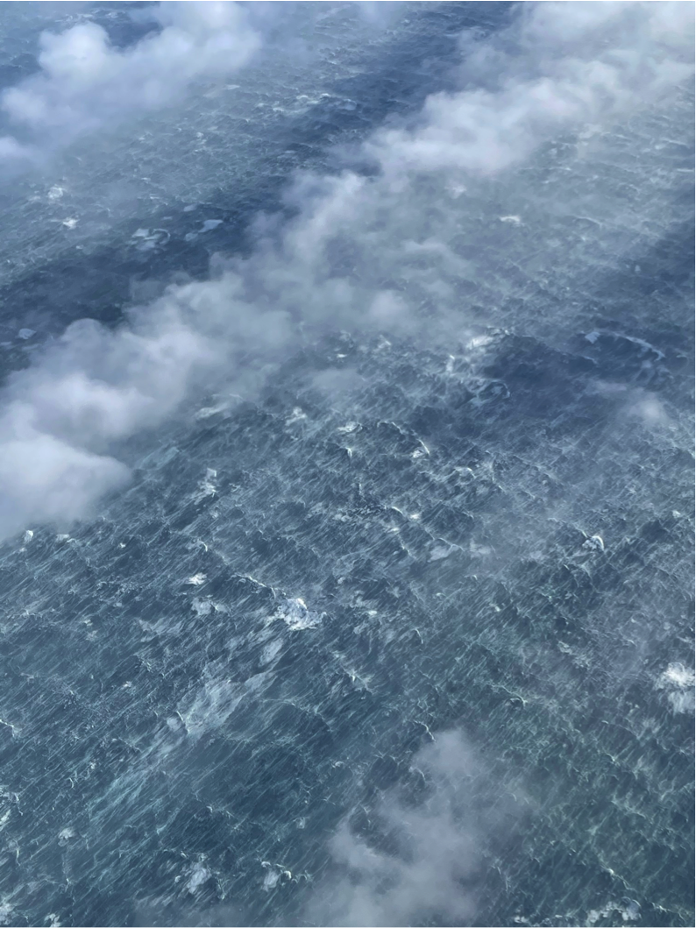
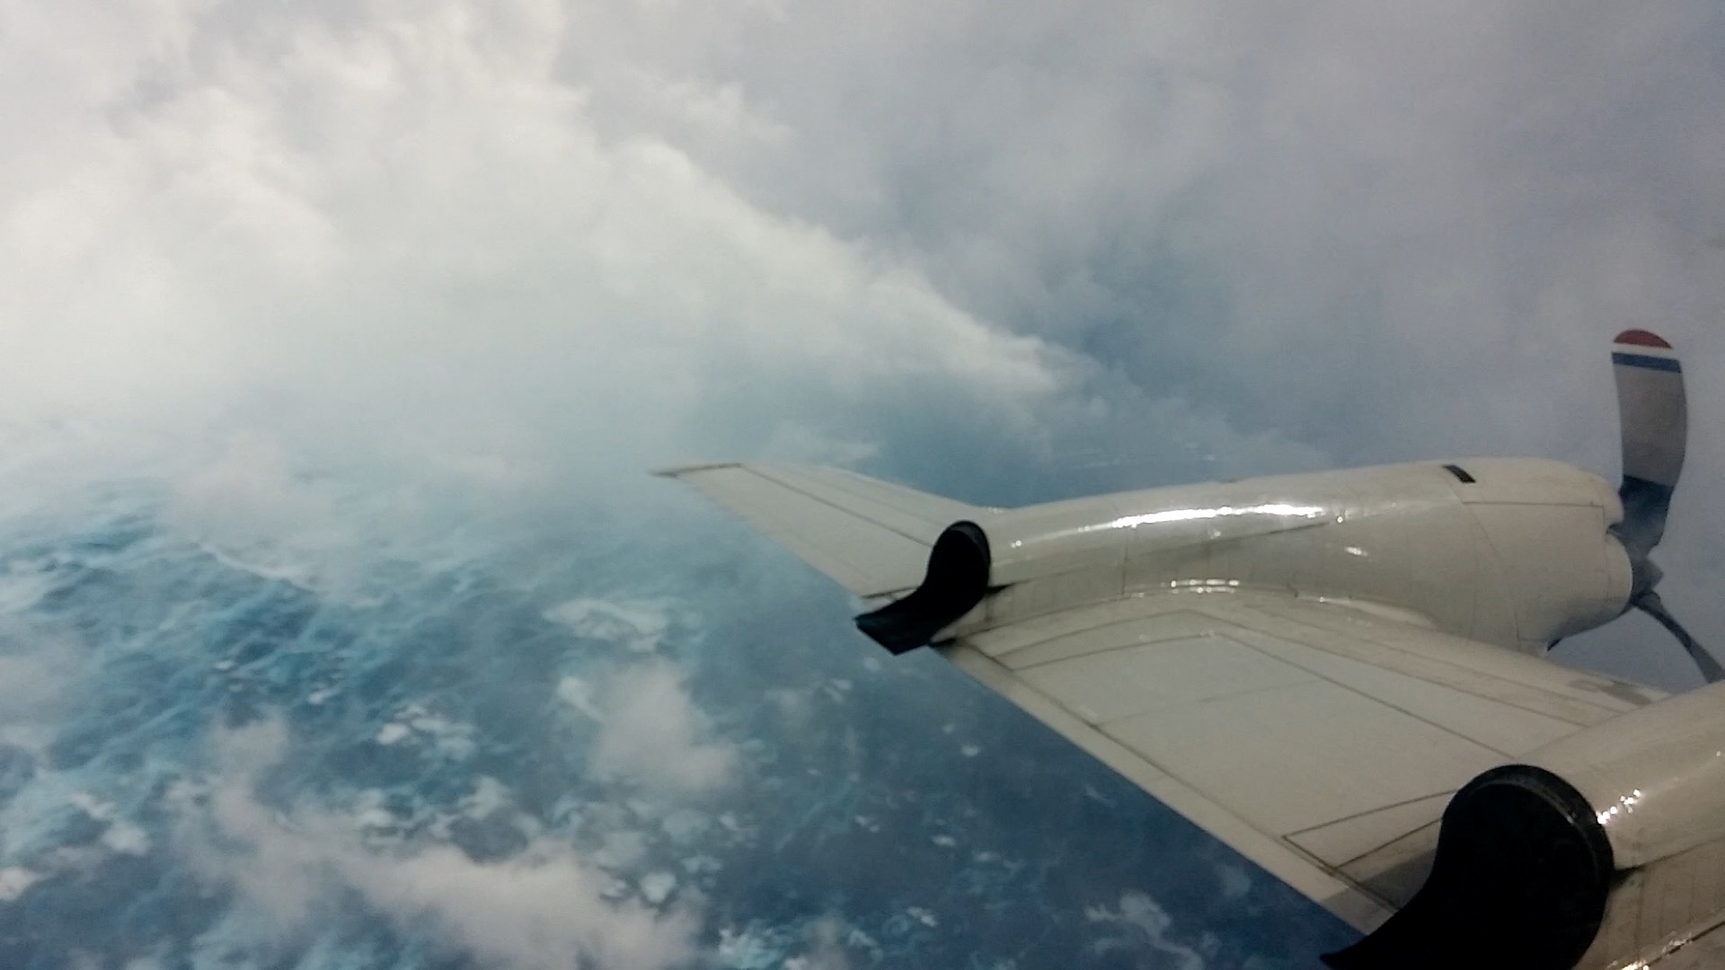
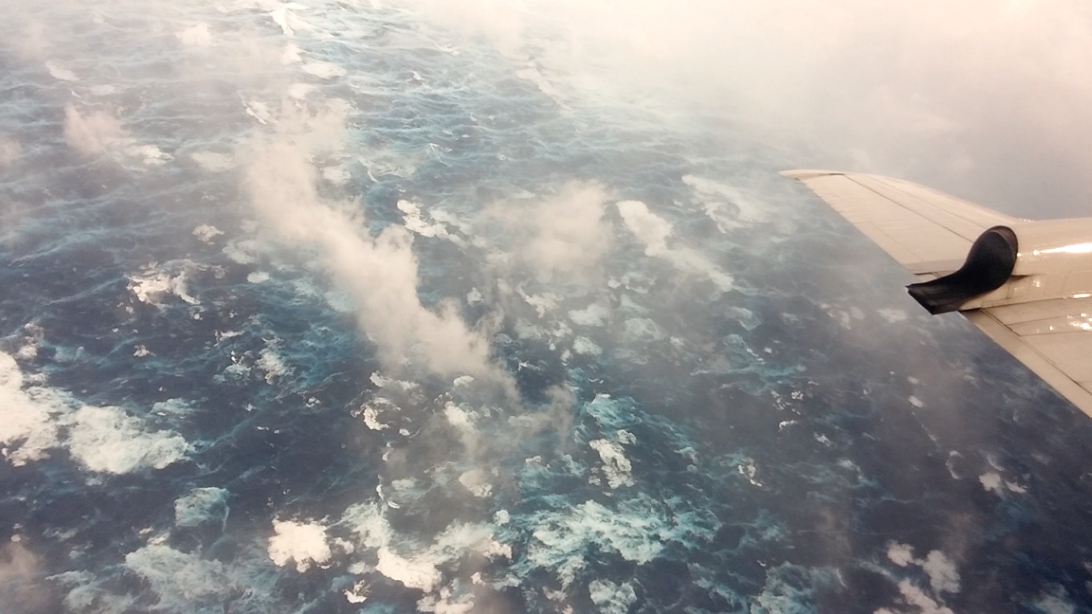
Backup
Gap wind event
Kennedy Entrance, AK
Huricane Patricia
Huricane Patricia

